Slide 1
SRM Institute of Science and Technology Advanced Programming Practice-18CSC207J Unit 1

Slide 2
Overview of the Unit
Structured Programming Paradigm
Procedural Programming Paradigm
Object Oriented Programming Paradigm

Slide 3
Structured Programming Paradigm
Unit-I (15 Session)
Session 1-5 cover the following topics:-
Structured Programming Paradigm
Programming Language Theorem
Böhm-Jacopini theorem
Sequence, Selection,Decision,Iteration and Recursion
Other Languages- : C/C++/Java /C# /Ruby (introduction of each language)
Demo: Structured Programing in Python
Lab 1: Structured Programming
Assignment : Comparative study of C/C++/Java /C# /Ruby
TextBook: Shalom, Elad. A Review of Programming Paradigms Throughout the History: With a Suggestion Toward a Future Approach, Kindle Edition

Slide 4
2.Procedural Programming Paradigm
Session 6 – 10 covers the following Topics:-
Procedural Programming Paradigm
Routines, Subroutines, Functions
Using Functions in Python
logical view, control flow of procedural programming in various aspects
Other languages: Bliss, ChucK, Matlab
Demo: creating routines and subroutines using functions in Python
Lab 2: Procedural Programming
Assignment : Comparative study of : Bliss, ChucK, Matlab
TextBook: Shalom, Elad. A Review of Programming Paradigms Throughout the History: With a Suggestion Toward a Future Approach, Kindle Edition

Slide 5
3. Object-Oriented Programming
Session 11-15 covers the following Topics:-
Object Oriented Programming Paradigm
Class, Objects, Instances, Methods
Encapsulation, Data Abstraction
Polymorphism, Inheritance
Constructor, Destructor
Example Languages: BETA, Cecil, Lava.
Demo: OOP in Python
Lab 3: Object Oriented Programming
Assignment : Comparative Study of BETA, Cecil, Lava.
TextBook: Shalom, Elad. A Review of Programming Paradigms Throughout the History: With a Suggestion Toward a Future Approach

Slide 6
What is Programming Paradigm?
A programming paradigm is a fundamental style of computer programming, serving as a way of building the structure and elements of computer programs.
Various programming languages have different capabilities and styles and they are defined by their supported programming paradigms.
Some programming languages follow only one paradigm [Smalltalk - object-oriented and Haskell - functional] , while others support multiple paradigms. [ C++, Java, C#, Scala, Python, Ruby…]

Slide 7
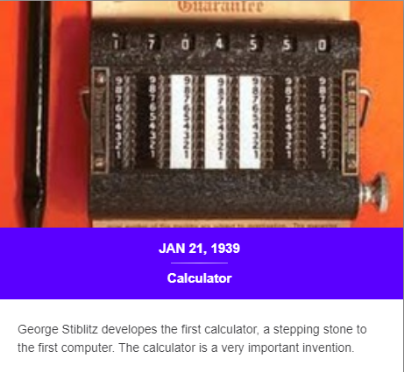
HISTORY !!

Slide 8
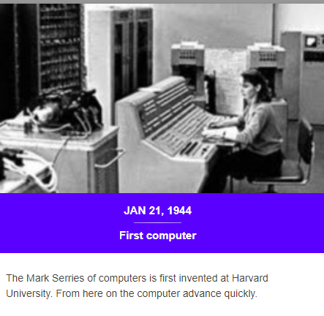

Slide 9
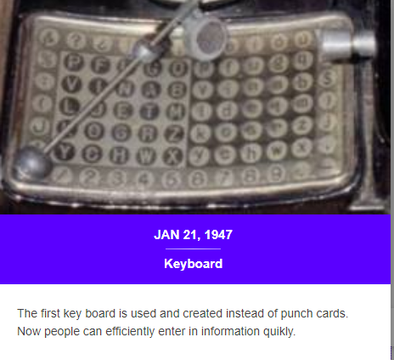

Slide 10
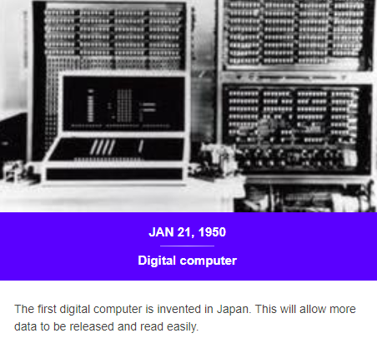

Slide 11
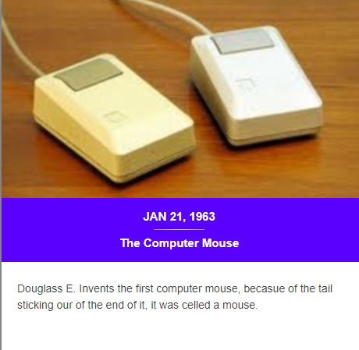

Slide 12
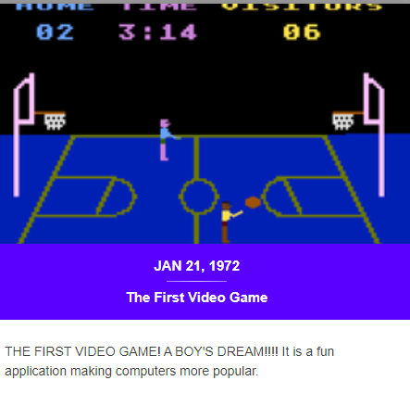

Slide 13
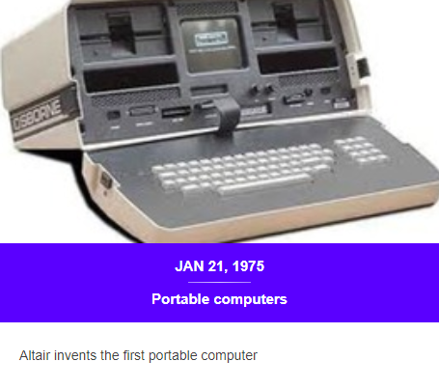

Slide 14
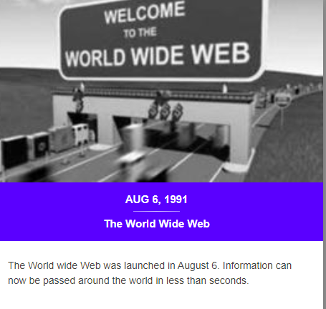

Slide 15
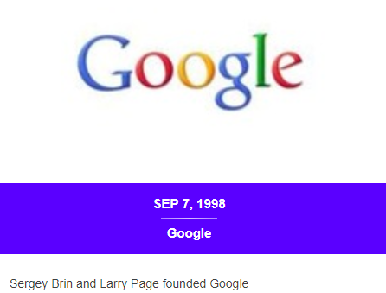

Slide 16
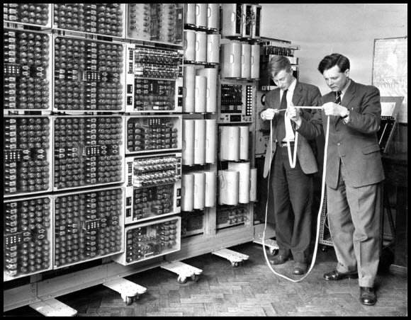
Gallery of Giant, Ancient Computers

Slide 17
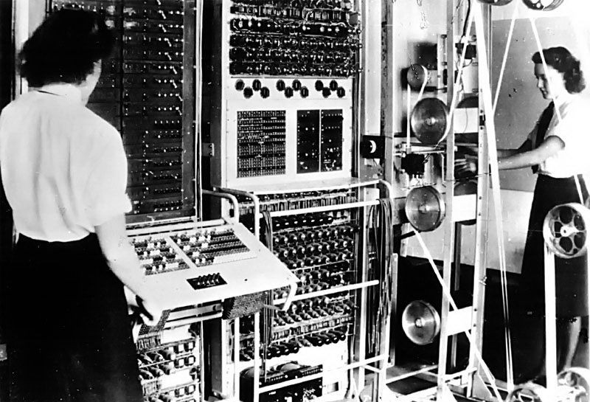

Slide 18
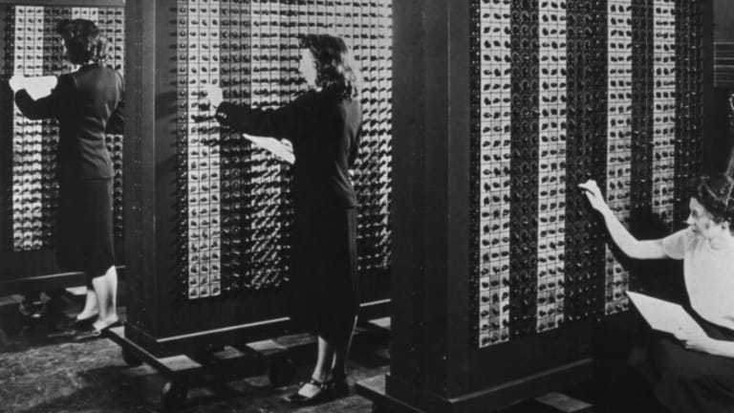

Slide 19
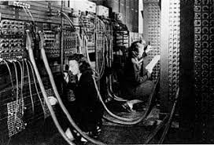

Slide 20
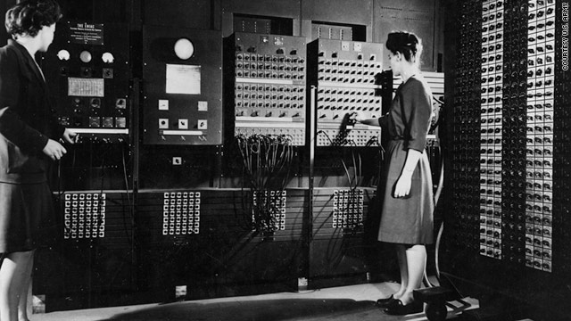

Slide 21
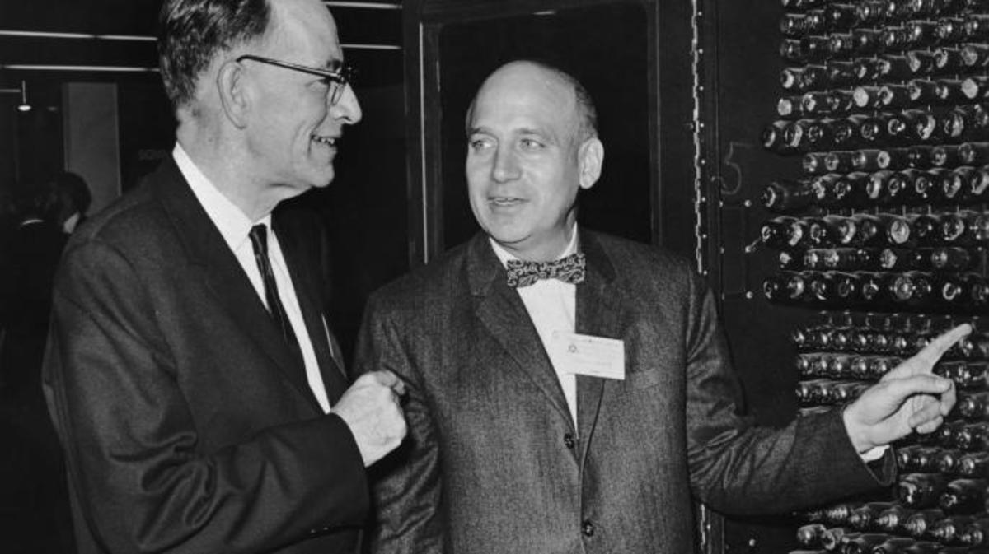
John Mauchly and Dr Presper Eckert Jr looking at a portion of ENIAC, which they co-designed in 1946. (Credit: Hulton Archive/Getty Images)

Slide 22
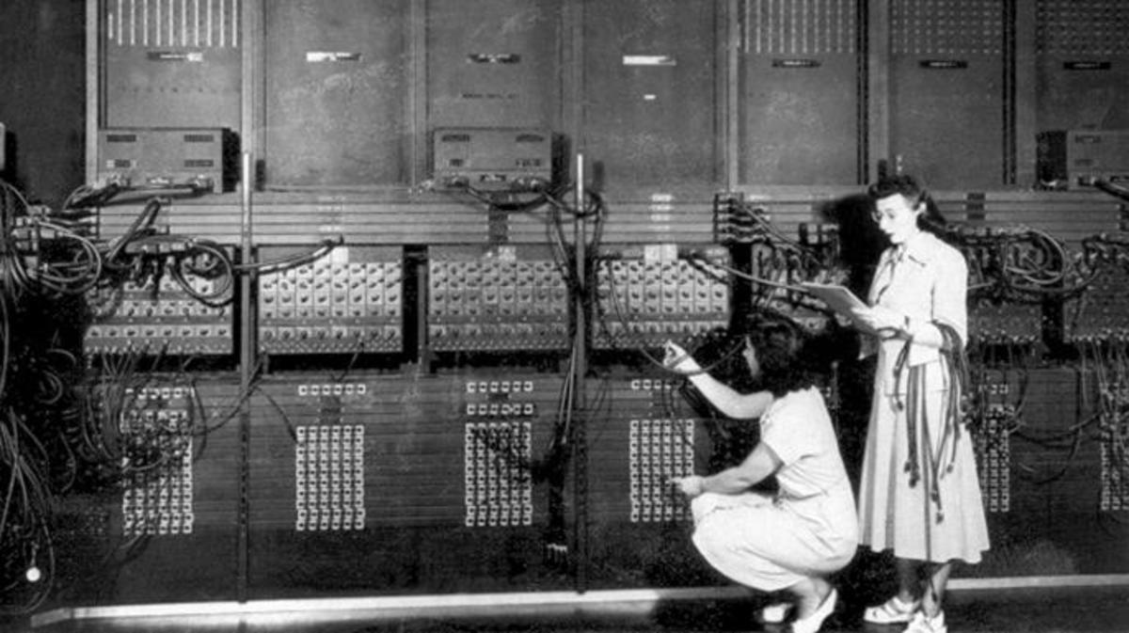
The ENIAC, the first electronic computer, being developed at the University of Pennsylvania, 1946. (Credit: Apic/Getty Images)

Slide 23
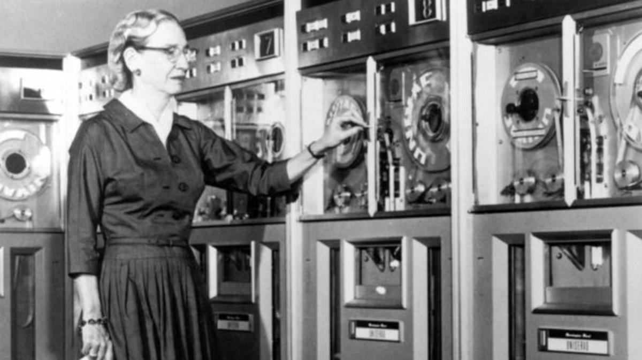
Programmer Grace Hopper, who invented the first computer language compiler (which transferred mathematical code into machine code), also used gender stereotypes to encourage women to enter the field

Slide 24
History of programming languages
Programming language is “a notation for communicating to a computer what we want it to do
Machine language
Assembly language
FORTRAN and algebraic notation
Structured abstractions and machine independence
Computation without the von Neumann architecture

Slide 25
MACHINE LANGUAGE
Instead of turning off the computer to reconfigure its circuits, the operator could flip switches to enter these codes, expressed in machine language, into computer memory.
0010001000000100
0010010000000100
0001011001000010
0011011000000011
1111000000100101
0000000000000101
0000000000000110
0000000000000000
16 bits - single machine language instruction
4 bits - Opcode
12 bits instruction code

Slide 26
ASSEMBLY LANGUAGE
Assembly language relies on software tools to automate some of the tasks of the programmer
A program called an assembler translates the symbolic assembly language code to binary machine code.
Programmers also used a pair of new input devices – a keypunch machine to type their assembly language codes and a card reader to read the resulting punched cards into memory for the assembler.
ORIG x3000;
LD R1, FIRST;
LD R2, SECOND;
ADD R3, R2, R1;
ST R3, SUM;
HALT;
FIRST .FILL #5 ;
SECOND .FILL #6 ;
SUM .BLKW #1 ;
.END ;
DISADVANTAGE
Abstract mathematical idea
Computer hardware architecture

Slide 27
FORTRAN AND ALGEBRAIC NOTATION
Unlike assembly language, high-level languages (Java, Python, C, …) support notations closer to the abstractions, such as algebraic expressions, used in mathematics and science.
int first = 5;
int second = 6;
int sum = first + second;
FORTRAN - FORmula TRANslation language

Slide 28
STRUCTURED ABSTRACTIONS AND MACHINE INDEPENDENCE
Higher level of abstraction and Portability
ALGOL – Algorithm - the language included notations for structured control statements for sequencing, loops, and selection. Finally, support for procedures, including recursive procedures, was provided.
ALGOL and ALGOL compiler
Pascal and Ada

Slide 29
COMPUTATION WITHOUT THE VON NEUMANN ARCHITECTURE
von Neumann architecture : consists of an area of memory where both programs and data are stored and a separate central processing unit that sequentially executes instructions fetched from memory.
relied upon changes to the values of variables
single-processor model of computation Vs multiple CPUs
Programming languages need not be based on any particular model of hardware, but need only support models of computation suitable for various styles of problem solving

Slide 30
LANGUAGE CATEGORIES
Imperative
Functional
Logic
Object-oriented.
IMPERATIVE
VISUAL LANGUAGE
Eg: .NET
OBJECT ORIENTED
LOGIC PROGRAMMING
MARKUP LANGUAGES
HTML - Hyper Text Mark-up Language
JSTL - Java Server Pages Standard Tag Library
XSTL - eXtensible Stylesheet Language Transformations
SPECIAL-PURPOSE
RPG - Report Program Generator (RPG),
APT - Automatically Programmed Tools GPSS - General Purpose Simulation System
SCRIPTING LANGUAGE
Eg: Perl, JavaScript, Ruby

Slide 31
IMPORTANCE OF VARIOUS PROGRAMMING CONCEPTS
Increased capacity to express ideas
does not directly support some features and constructs
Improved background for choosing appropriate languages
Increased ability to learn new languages
Better understanding of the significance of implementation
Better use of languages that are already known
Overall advancement of computing – ALGOL 60 & FORTRAN

Slide 32
Structured Programming
Structured programming is a paradigm that is based on improving clarity and quality of programs by using subroutines, block structures and loops (for and while) and discouraging the use of goto statement.
1. History
2. Overview
3. Component
4. Representations in different languages(C, C++, Java, Python)

Slide 33
History
The Böhm-Jacopini theorem, also called structured program theorem, stated that working out a function is possible by combining subprograms in only three manners:
Executing one subprogram, and the other subprogram (sequence) .
Executing one of two subprograms according to the value of a Boolean expression (selection) .
Executing a subprogram until a Boolean expression is true (iteration)

Slide 34
Some of the languages that initially used structured approach are ALGOL, Pascal, PL/I and Ada.
By the end of the 20th century, concepts of structured programming were widely applied so programming languages that originally lacked structure now have it (FORTRAN, COBOL and BASIC). Now, it is possible to do structured programming in any programming language (Java, C++, Python ...).

Slide 35
2. Overview
Structured programming was defined as a method used to minimize complexity that uses:
1. Top-down analysis for problem solving
2. Modularization for program structure and organization
3. Structured code for the individual modules
The statements within a specific control structure are executed:
Sequentially
Conditionally
Repetitively

Slide 36
ADVANTAGES OF STRUCTURED PROGRAMMING
Programs are more easily and more quickly written.
Programs have greater reliability.
Programs require less time to debug and test.
Programs are easier to maintain.

Slide 37
3.Component
3.1 Structograms
3.2 Subroutine
3.3 Block
3.4 Indentation
3.5. Control structure – sequence, selection and iteration

Slide 38
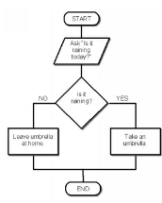
Component
Structograms or Nassi–Shneiderman -graphical representation of structured programming.
Structograms can be compared to flowcharts.
Nassi–Shneiderman diagrams have no representation for a goto statement.
Ex:-

Slide 39
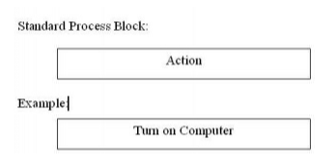
Structograms use the following diagrams:
1.process blocks - Process blocks represent the simplest actions and don’t require analysis. Actions are performed block by block.

Slide 40
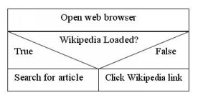
2.Branching blocks
Branching blocks are of two types – True/False or Yes/No block and multiple branching block.

Slide 41
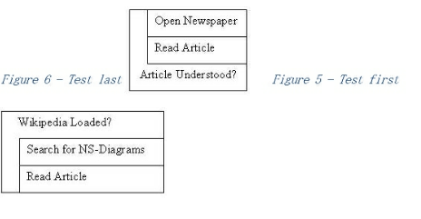
3.Testing loops
Testing loops allow the program to repeat one or many processes until a condition is fulfilled. There are two types of testing loops – test first and test last blocks – and the order in which the steps are performed is what makes them different.

Slide 42
3.2. Subroutine
Procedure,
Function
Routine
Method
Subprogram.
Callable unit - Generic term.

Slide 43
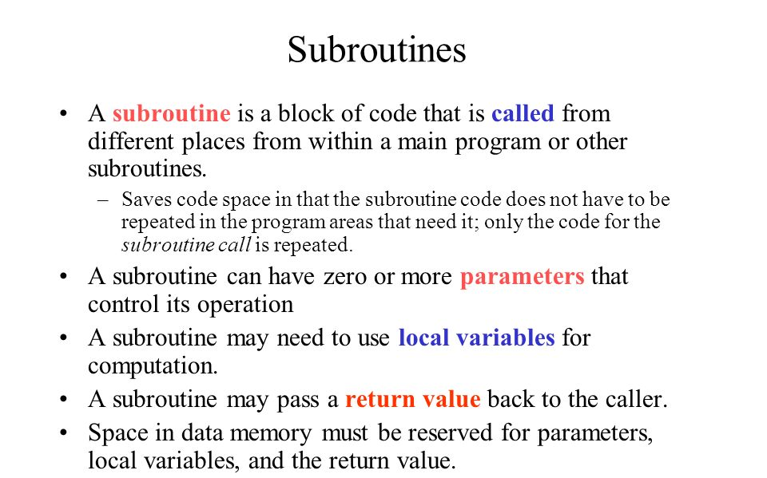

Slide 44
Block
Two types of blocks can be distinguished based on their location within a program:
block associated with a procedure
in-line block

Slide 45
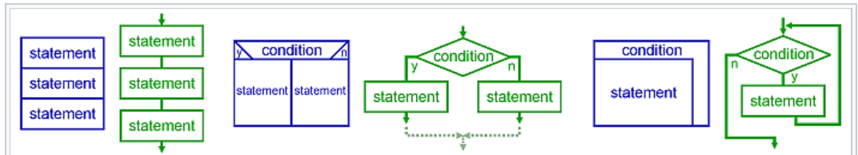
Control structure – sequence, selection ,iteration and recursion. (example for Control structure)
Recursion:
Recursion"; a statement is executed by repeatedly calling itself until termination conditions are met. While similar in practice to iterative loops, recursive loops may be more computationally efficient, and are implemented differently as a cascading stack.
Graphical representation of the three basic patterns — sequence, selection, and repetition

Slide 46
Note:
What is meant by structured language?
C is called a structured programming language because to solve a large problem, C programming language divides the problem into smaller modules called functions or procedures each of which handles a particular responsibility. The program which solves the entire problem is a collection of such functions
Examples of Structured Programming language are C, C+, C++, C#, Java, PERL, Ruby, PHP, ALGOL, Pascal, PL/I and Ada
What is unstructured programming language?
An unstructured program is a procedural program – the statements are executed in sequence as written. But this type of programming uses the goto statement. A goto statement allows control to be passed to any other place in the program. ... This means that it is often difficult to understand the logic of such a program.
Examples of unstructured Programming language are JOSS, FOCAL, MUMPS, TELCOMP, COBOL

Slide 47
Control Structure - DECISION MAKING (PYTHON )
Decision making statements in programming languages decides the direction of flow of program execution. Decision making statements available in python are:
if statement :
It is used to decide whether a certain statement or block of statements will be executed or not i.e if a certain condition is true then a block of statement is executed otherwise not.
Syntax:
if condition:
# Statements to execute if
# condition is true
Example :
i = 10
if (i > 15):
print ("10 is less than 15")
print ("I am Not in if”)
OUTPUT
I am Not in if

Slide 48
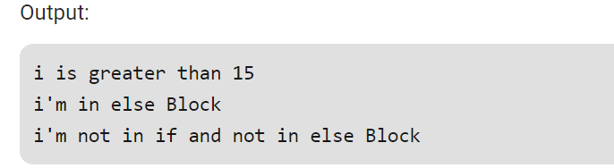
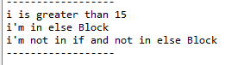
if..else statements:
We can use the else statement with if statement to execute a block of code when the condition is false.
Syntax:
if (condition):
# Executes this block if
# condition is true
else:
# Executes this block if
# condition is false
Example :
i = 20;
if (i < 15):
print ("i is smaller than 15")
print ("i'm in if Block")
else:
print ("i is greater than 15")
print ("i'm in else Block")
print ("i'm not in if and not in else Block")

Slide 49
NESTED IF STATEMENTS
Python allows us to nest if statements within if statements. i.e, we can place an if statement inside another if statement.
Syntax:
if (condition1):
# Executes when condition1 is true
if (condition2):
# Executes when condition2 is true
# if Block is end here
# if Block is end here

Slide 50
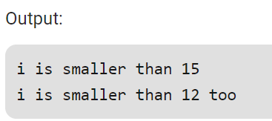
EXAMPLE : NESTED IF ELSE
i = 10
if (i == 10):
if (i < 15):
print ("i is smaller than 15")
if (i < 12):
print ("i is smaller than 12 too")
else:
print ("i is greater than 15")

Slide 51
IF-ELIF-ELSE LADDER
Here, a user can decide among multiple options. The if statements are executed from the top down. As soon as one of the conditions controlling the if is true, the statement associated with that if is executed, and the rest of the ladder is bypassed. If none of the conditions is true, then Syntax:-
Syntax:-
if (condition):
statement
elif (condition):
statement
else:
statement the final else statement will be executed.

Slide 52
EXAMPLE
i = 20
if (i == 10):
print ("i is 10")
elif (i == 15):
print ("i is 15")
elif (i == 20):
print ("i is 20")
else:
print ("i is not present")
OUTPUT
i is 20

Slide 53
CONDITION | SYNTAX
SIMPLE IF | if test expression: statement(s)
IF….ELSE | if test expression: Body of if else: Body of else
IF...ELIF...ELSE | if test expression: Body of if elif test expression: Body of elif else: Body of else
NESTED IF | if test expression: if test expression: Body of if else: Body of else else: Body of else

Slide 54
Conditional Expression
A conditional expression evaluates an expression based on a condition.
Conditional expression is expressed using if and else combined with expression
Syntax:
expression if Boolean-expression else expression
Example:
Biggest of two numbers
num1 = 23
num2 = 15
big = num1 if num1 > num2 else num2
print ( “ The biggest number is “ , big )
Even or odd
print ( “ num is even “ if num % 2 == 0 else “ num is odd “)
OUTPUT
The biggest number is 23
OUTPUT
Num is even

Slide 55
Iteration – Loops
Python has two primitive loop commands:
while loops
for loops

Slide 56
The while Loop
With the while loop we can execute a set of statements as long as a condition is true
Example
Print i as long as i is less than 6:
i = 1 while i < 6: print(i) i += 1
OUTPUT
1
2
3
4
5
Note: remember to increment i, or else the loop will continue forever.

Slide 57
The break Statement
With the break statement we can stop the loop even if the while condition is true:
Example - Exit the loop when i is 3:
i = 1
while i < 6:
print(i)
if i == 3:
break
i += 1
OUTPUT
1
2
3

Slide 58
THE CONTINUE STATEMENT
With the continue statement we can stop the current iteration, and continue with the next:
Example
Continue to the next iteration if i is 3:
i = 0 while i < 6: i += 1 if i == 3: continue print(i)
OUTPUT
1
2
4
5
6

Slide 59
The else Statement
With the else statement we can run a block of code once when the condition no longer is true:
Example
Print a message once the condition is false:
i = 1 while i < 6: print(i) i += 1 else: print("i is no longer lesser than 6")
OUTPUT
1
2
3
4
5
i is no longer lesser than 6

Slide 60
For Loops
A for loop is used for iterating over a sequence (that is either a list, a tuple, a dictionary, a set, or a string)
Example
Print each fruit in a fruit list:
fruits = ["apple", "banana", "cherry"]
for x in fruits:
print(x)
The for loop does not require an indexing variable to set beforehand
OUTPUT
apple
banana
cherry

Slide 61
Looping Through a String
Even strings are iterable objects, they contain a sequence of characters:
Example
Loop through the letters in the word "banana":
for x in "banana": print(x)
OUTPUT
b
a
n
a
n
a

Slide 62
THE BREAK STATEMENT
With the break statement we can stop the loop before it has looped through all the items:
Example
Exit the loop when x is "banana":
fruits = ["apple", "banana", "cherry"]
for x in fruits:
print(x)
if x == "banana":
break
OUTPUT
apple
banana

Slide 63
THE CONTINUE STATEMENT
With the continue statement we can stop the current iteration of the loop, and continue with the next:
Example
Do not print banana:
fruits = ["apple", "banana", "cherry"]
for x in fruits:
if x == "banana":
continue
print(x)
OUTPUT
apple
cherry

Slide 64
The range() Function
To loop through a set of code a specified number of times, we can use the range() function,
The range() function returns a sequence of numbers, starting from 0 by default, and increments by 1 (by default), and ends at a specified number.
Example
Using the range() function:
for x in range(6): print(x)
Note that range(6) is not the values of 0 to 6, but the values 0 to 5.
OUTPUT
0
1
2
3
4
5

Slide 65
The range() function defaults to 0 as a starting value, however it is possible to specify the starting value by adding a parameter: range(2, 6), which means values from 2 to 6 (but not including 6):
Example
Using the start parameter:
for x in range(2, 6): print(x)
The range() function defaults to increment the sequence by 1, however it is possible to specify the increment value by adding a third parameter: range(2, 30, 3):
OUTPUT
2
3
4
5

Slide 66
Example
Increment the sequence with 3 (default is 1):
for x in range(2, 30, 3): print(x)
OUTPUT
2
5
8
11
14
17
20
23
26
29

Slide 67
Else in For Loop
The else keyword in a for loop specifies a block of code to be executed when the loop is finished:
Example
Print all numbers from 0 to 5, and print a message when the loop has ended:
for x in range(6):
print(x)
else:
print("Finally finished!")
OUTPUT
0
1
2
3
4
5
Finally finished!

Slide 68
Nested Loops
A nested loop is a loop inside a loop.
The "inner loop" will be executed one time for each iteration of the "outer loop":
Example
Print each adjective for every fruit:
adj = ["red", "big", "tasty"] fruits = ["apple", "banana", "cherry"] for x in adj: for y in fruits: print(x, y)
OUTPUT
red apple
red banana
red cherry
big apple
big banana
big cherry
tasty apple
tasty banana
tasty cherry
Reference : https://www.w3schools.com/python/python_for_loops.asp

